Slide 1
Digital Logic Design
Chapter 4
Combinational Logic

Slide 2
Combinational & Sequential Circuits
A combinational circuit performs a specified information-processing operation fully specified logically by a set of Boolean functions.
A sequential circuit employs memory elements (binary cells) in addition to logic gates. The state of memory elements in turn is a function of previous inputs.

Slide 3
Design Procedure
The procedure involve the following steps:
The problem is stated.
The number of available input variables and required output variables is determined.
The input and output variables are assigned letter symbols.
The truth table that defines the required relationships between inputs and outputs is derived.
The simplified Boolean function for each output is obtained.
The logic diagram is drawn.

Slide 4
Adders
The binary sum consists of two digits. The higher significant bit of this result is called a carry.
There are two types of adders:
Half-adder
Full-adder
Half-Adder: A combinational circuit that performs the addition of two bits is called a half-adder.
Full-Adder: One that performs the addition of three bits (two significant bits and a previous carry) is a full-adder.

Slide 5
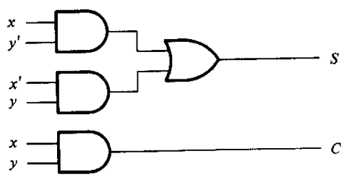
Half-Adder
We arbitrarily assign symbols x and y to the two inputs and S (for sum) and C (for carry) to the ouputs.
S = x’y + xy’
C = xy
x | y | S | C
0 | 0 | 0 | 0
0 | 1 | 1 | 0
1 | 0 | 1 | 0
1 | 1 | 0 | 1

Slide 6
Full-Adder
It consists of three inputs and two outputs.
Two of the input variables, denoted by x and y, represent the two significant bits to be added.
The third input, z represents the carry from the previous lower significant position.

Slide 7
Full-Adder
x | y | z | S | C
0 | 0 | 0 | 0 | 0
0 | 0 | 1 | 1 | 0
0 | 1 | 0 | 1 | 0
0 | 1 | 1 | 0 | 1
1 | 0 | 0 | 1 | 0
1 | 0 | 1 | 0 | 1
1 | 1 | 0 | 0 | 1
1 | 1 | 1 | 1 | 1

Slide 8
Full-Adder
S = x’y’z + x’yz’ + xy’z’ + xyz
yz x | 00 | 01 | 11 | 10
0 | 0 | 1 | 0 | 1
1 | 1 | 0 | 1 | 0
yz x | 00 | 01 | 11 | 10
0 | 0 | 0 | 1 | 0
1 | 0 | 1 | 1 | 1
C = xy + xz +yz

Slide 9
Subtractors
In subtraction, two number x and y are subtracted in each bit. When a bit of x is smaller than the corresponding bit of y, a 1 is borrowed.
Like adders, there are two types of subtractors:
Half-subtractor
Full-subtractor
Half-Subtractor: A combinational circuit that subtracts two bits and produces their difference is called a half-adder.
Full-Subtractor: A combinational circuit that performs the subtraction between two bits taking into account that a 1 may have been borrowed by a lower significant stage is a full-adder.

Slide 10
Half-Subtractor
We arbitrarily assign symbols x and y to the two inputs and B (for borrow) and D (for difference) to the outputs.
D = x’y + xy’
B = x’y
x | y | B | D
0 | 0 | 0 | 0
0 | 1 | 1 | 1
1 | 0 | 0 | 1
1 | 1 | 0 | 0

Slide 11
Full-Subtractor
It consists of three inputs and two outputs.
Two of the input variables, denoted by x and y, represent the two significant bits to be subtracted.
The third input, z represents the previous borrow.
The two outputs, D and B represent the difference and output borrow respectively.

Slide 12
Full-Subtractor
x | y | z | B | D
0 | 0 | 0 | 0 | 0
0 | 0 | 1 | 1 | 1
0 | 1 | 0 | 1 | 1
0 | 1 | 1 | 1 | 0
1 | 0 | 0 | 0 | 1
1 | 0 | 1 | 0 | 0
1 | 1 | 0 | 0 | 0
1 | 1 | 1 | 1 | 1

Slide 13
Full-Subtractor
yz x | 00 | 01 | 11 | 10
0 | 0 | 1 | 0 | 1
1 | 1 | 0 | 1 | 0
D = x’y’z + x’yz’ + xy’z’ + xyz
yz x | 00 | 01 | 11 | 10
0 | 0 | 1 | 1 | 1
1 | 0 | 0 | 1 | 0
B = x’y + x’z +yz

Slide 14
Code Conversion
Sometimes it becomes necessary to convert binary code of one system to another.
A combinational circuit performs this transformation by means of logic gates.
Let us convert a number represented in BCD to excess-3 codes.
We designate the four input binary variables A, B, C and D and four output binary variable w, x, y and z.
For four variables, there should be 16 combinations. But we have to use only 10 combinations. The remaining are don’t care combinations.

Slide 15
Code Conversion
A | B | C | D | w | x | y | z
0 | 0 | 0 | 0 | 0 | 0 | 1 | 1
0 | 0 | 0 | 1 | 0 | 1 | 0 | 0
0 | 0 | 1 | 0 | 0 | 1 | 0 | 1
0 | 0 | 1 | 1 | 0 | 1 | 1 | 0
0 | 1 | 0 | 0 | 0 | 1 | 1 | 1
0 | 1 | 0 | 1 | 1 | 0 | 0 | 0
0 | 1 | 1 | 0 | 1 | 0 | 0 | 1
0 | 1 | 1 | 1 | 1 | 0 | 1 | 0
1 | 0 | 0 | 0 | 1 | 0 | 1 | 1
1 | 0 | 0 | 1 | 1 | 1 | 0 | 0

Slide 16
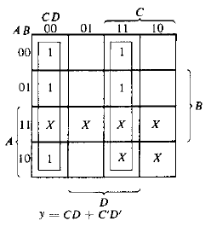
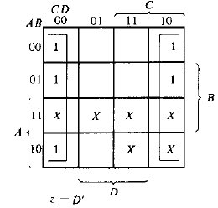
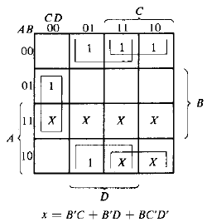
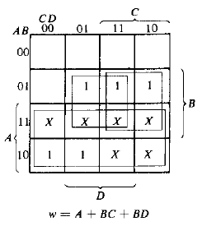
Code Conversion

Slide 17
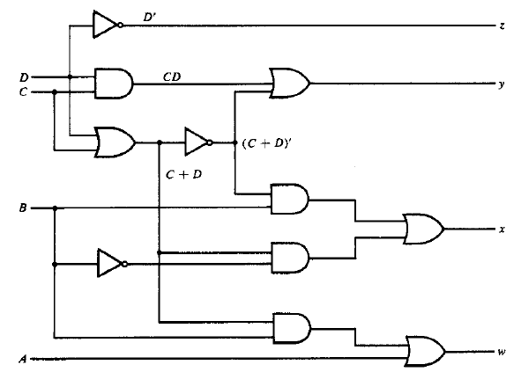
Code Conversion
z = D’
y = CD + C’D’
= CD + (C+D)’
x = B’C + B’D + BC’D’
= B’(C+D) + BC’D’
= B’(C+D) + B(C+D)’
w = A + BC + BD
= A + B(C+D)

Slide 18
Analysis Procedure
The analysis of a combinational circuit is somewhat the reverse process.
It starts with a given logic diagram and ends with a set of Boolean functions, a truth table or a verbal explanation of the circuit operation.
We need to consider the feedback path which is a connection from the output of one gate to the input of a second gate that forms part of the input to the first gate.

Slide 19
Analysis Procedure
To obtain the output Boolean functions from a logic diagram, let us proceed as follows:
Label all gate outputs that are a function of the input variables.
Label with other symbols those gates which are a function of input variables and/or previously labeled gates.
Repeat this process until the outputs of the circuit are obtained.
By repeated substitution of previously defined functions, obtain output Boolean functions in terms of input variables only.

Slide 20
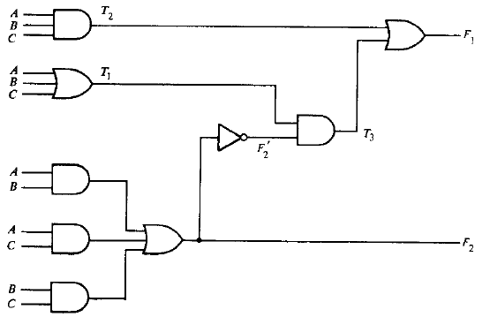
Analysis Procedure
F₂ = AB + AC + BC
T₁ = A + B + C
T₂ = ABC
T₃ = F₂’T₁
F₁ = T₃ + T₂
= F₂’T₁ + ABC
= (AB + AC + BC)’(A + B + C) + ABC
= (A’ + B’)(A’ + C’)(B’ + C’)(A + B + C) + ABC
= (A’ + B’C’)(AB’ + AC’ + BC’ + B’C’) + ABC
= A’BC’ + A’B’C + AB’C’ + ABC

Slide 21
Analysis Procedure
A | B | C | F₂ | F₂’ | T₁ | T₂ | T₃ | F₁
0 | 0 | 0 | 0 | 1 | 0 | 0 | 0 | 0
0 | 0 | 0 | 0 | 1 | 1 | 0 | 1 | 1
0 | 0 | 1 | 0 | 1 | 1 | 0 | 1 | 1
0 | 0 | 1 | 1 | 0 | 1 | 0 | 0 | 0
0 | 1 | 0 | 0 | 1 | 1 | 0 | 1 | 1
0 | 1 | 0 | 1 | 0 | 1 | 0 | 0 | 0
0 | 1 | 1 | 1 | 0 | 1 | 0 | 0 | 0
0 | 1 | 1 | 1 | 0 | 1 | 1 | 0 | 1

Slide 22
Exercise
Problems:
4-1, 4-3, 4-4, 4-7, 4-8, 4-10, 4-12, 4-15, 4-16

